Slide 1
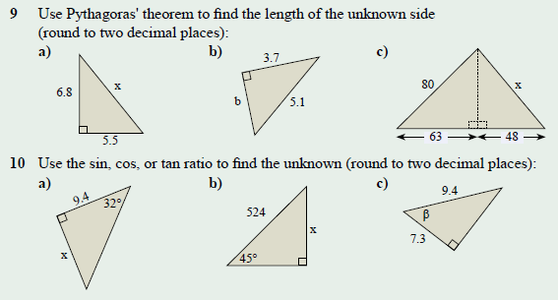
Mental set
Notes:
hook

Slide 2
Lesson objective
By the end of this lesson you will be able to;
- You will be able to use angles of elevation and depression to the distance of an object
Notes:
Lesson

Slide 3
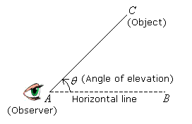
24
7
30
Date
Angles of Elevation and Depression
EQ – How do you use Angles of Elevation and Depression
The angle of elevation is the angle between a horizontal line from the observer and the line of sight to an object that is above the horizontal line.
In the diagram below, AB is the horizontal line. θ is the angle of elevation from the observer at A to the object at C.
What is the Angle of Elevation
5
Notes:
Input

Slide 4
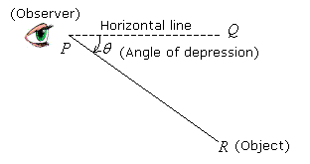
24
7
30
Date
Angles of Elevation and Depression
EQ – How do you use Angles of Elevation and Depression
What is the Angle of Depression
The angle of depression is the angle between a horizontal line from the observer and the line of sight to an object that is below the horizontal line.
In the diagram below, PQ is the horizontal line. θ is the angle of depression from the observer at P to the object at R.
5
Notes:
Input

Slide 5
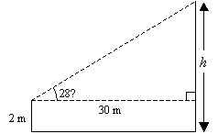
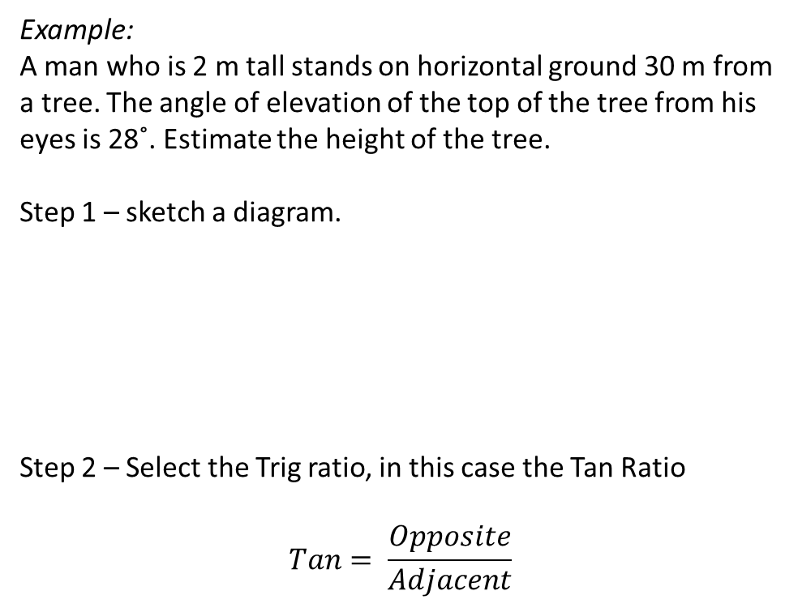
24
7
30
Date
Angles of Elevation and Depression
EQ – How do you use Angles of Elevation and Depression
Example:
A man who is 2 m tall stands on horizontal ground 30 m from a tree. The angle of elevation of the top of the tree from his eyes is 28˚. Estimate the height of the tree.
Step 1 – sketch a diagram.
Step 2 – Select the Trig ratio, in this case the Tan Ratio
$$Tan= \frac{Opposite}{Adjacent}$$
5
Notes:
Input

Slide 6
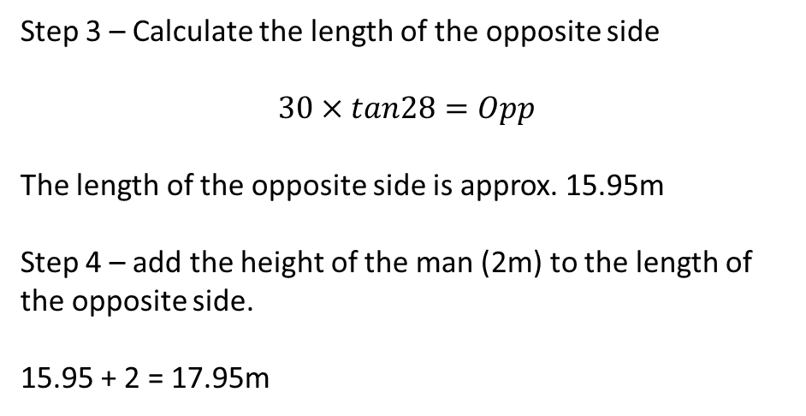
24
7
30
Date
Angles of Elevation and Depression
EQ – How do you use Angles of Elevation and Depression
Step 3 – Calculate the length of the opposite side
$$30×tan28=Opp$$
The length of the opposite side is approx. 15.95m
Step 4 – add the height of the man (2m) to the length of the opposite side.
15.95 + 2 = 17.95m
5
Notes:
Input

Slide 7
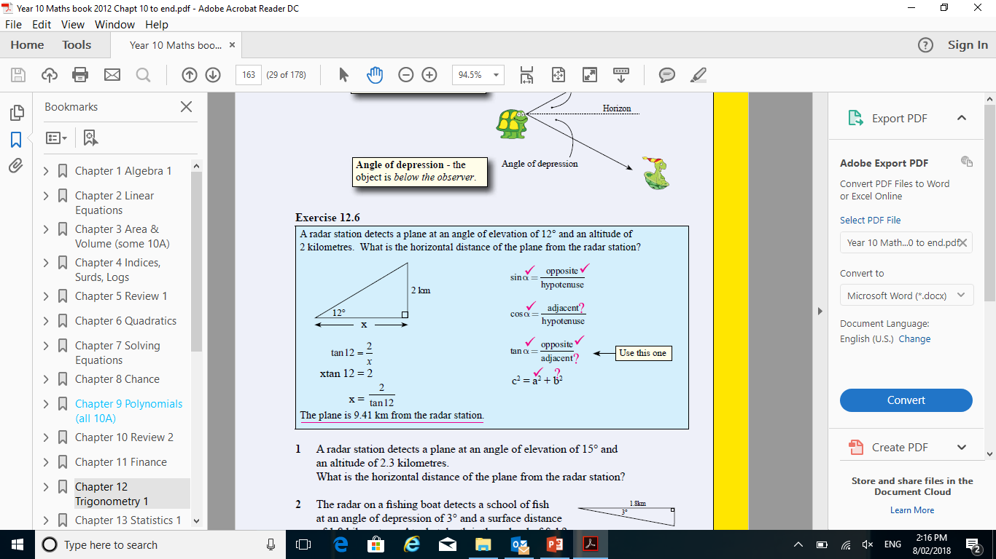
Guided Practice
Notes:
Guided practice

Slide 8
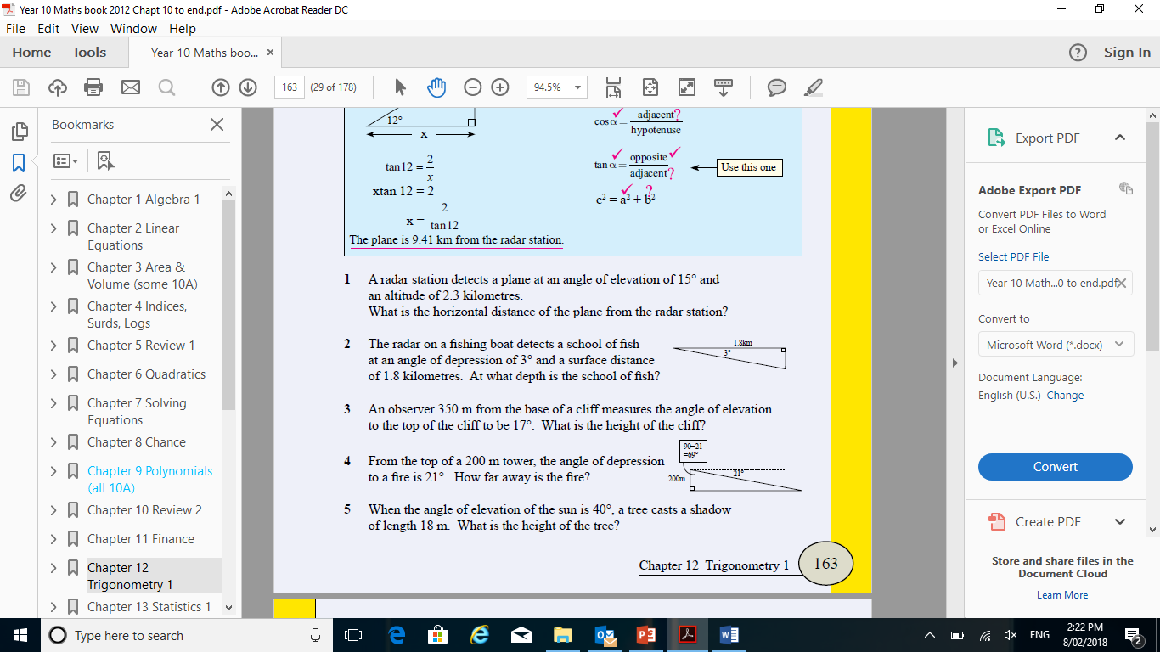
Activity
Notes:
Independent practice

Slide 9
Closure activity
Success Criteria
Thumbs up etc
Notes:
Closure

